Slide 1
We’ll be starting shortly...
Regional Workforce Alliance
Quarter 1
Note to Participants:
If you experience any difficulty connecting via Zoom at any time during the webinar please contact Wendy Angel at:
wangel@emeraldcities.org

Slide 2
Regional Workforce Alliance Q1 Thursday, March 31, 2022

Slide 3
Welcome
Minh Le
General Manager
Energy and Environmental Services
Los Angeles County, ISD
Lujuana Medina
Environmental Initiatives Manager
Energy and Environmental Services
Los Angeles County, ISD

Slide 5
Agenda
12:00 Welcome
12:10 Introductions
12:15 EDA Good Jobs Challenge Grant Proposal
12:35 SoCalREN WE&T Program Update
12:55 SoCalREN Business Plan (2024-2031)
1:15 Open Discussion
1:25 Next Steps
1:30 Closing Remarks

Slide 6
Meeting Objectives
Launch regional multi-stakeholder alliance to create career and business pathways into the Energy Efficiency sector
Identify areas to:
Guide & Advise
Collaborate & Innovate
Be Informed
Be an Advocate

Slide 7
Mission Statement & Goals for the Alliance

Slide 8
Mission:
Provide disadvantaged communities with equitable access to training and employment opportunities generated by investments in energy efficiency.
Goal:
Harness and coordinate the resources of industry, academic institutions and community-based organizations to develop a regional clean energy economic inclusion capacity building infrastructure to help meet the demand for skilled workers and contractors in the energy sector, with a specific focus on residents and businesses in disadvantaged communities.

Slide 9
Activities & Initiatives

Slide 10
EDA Good Jobs Challenge Grant Proposal

Slide 11
Southern California GREEN Careers Accelerator
Equip, Connect, Employ

Slide 12
grant overview.
The U.S. Economic Development Administration’s American Rescue Plan Good Jobs Challenge aims to get Americans back to work by building and strengthening systems and partnerships that bring together employers who have hiring needs with other key entities to train workers with in-demand skills that lead to good-paying jobs.
Purpose
EDA is allocating $500 million to collaborative skills training systems and programs. EDA encourages efforts to reach historically underserved populations and areas, communities of color, women, and other groups facing labor market barriers*
These systems and partnerships will create and implement industry-led training programs, designed to provide skills for and connect unemployed or underemployed workers to existing and emerging job opportunities.
Available Grant Funds
$500M for the Good Jobs Challenge
Awards: Between 25 and 50 awards at ~$5-25 million each
Grant Rate: Projects will be funded at a 100% grant rate; projects that leverage other funds will be more competitive
No match required
Job Placement Priority: Applicants should secure placements for trainees into quality jobs
Notes:
REMOVE

Slide 13
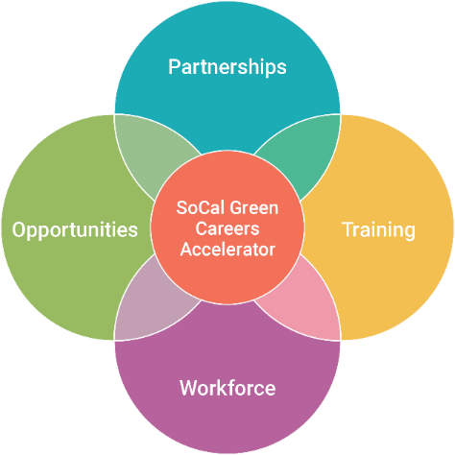
SoCal GREEN Careers Accelerator
This program’s objective is to advance equity within vulnerable communities by assisting individuals enter the Zero Emissions Transportation, Clean Energy, and Smart & Sustainable Cities sectors and increase wage growth, as well as develop demand-driven systems that will continue to support these community members in securing and retaining quality jobs.
This Program will…
Leverage and expand existing workforce models and infrastructure to form collaborative direct connections.
Identify gaps within the regional workforce market and implement strategies to fill those gaps.
Program Goals
Establish direct connections with industry employers, both large and small, that lead to job placement as well as mitigate skilled worker shortages.
Place 1,600 individuals in high quality jobs.
Ensure the clean energy workforce is inclusive and increases diversity of the clean energy industry.
Produce concrete, measurable impacts for workers in the region (e.g., employer commitments to hire, job placements, wage gain) while tracking progress against equity goals.

Slide 14
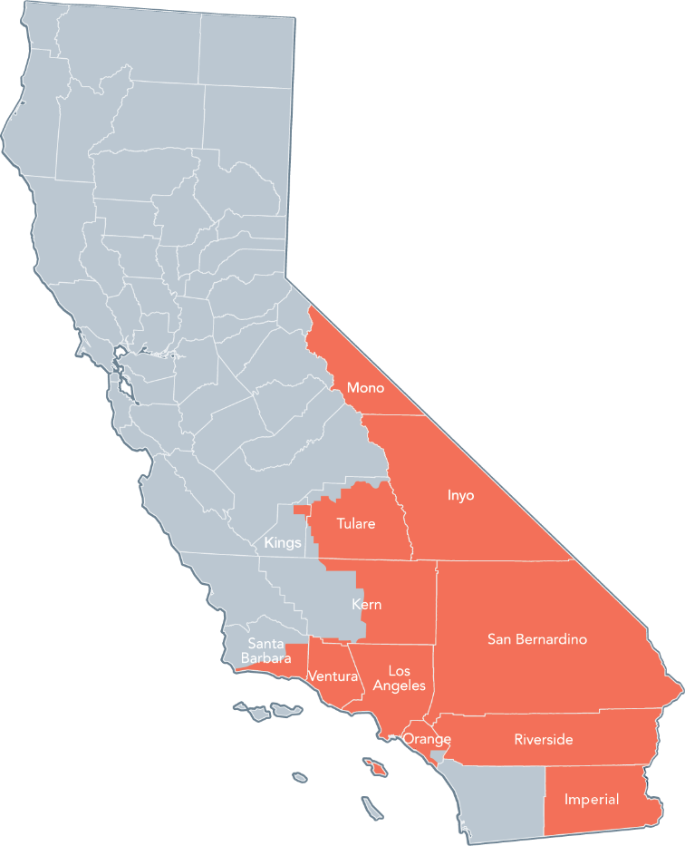
region.
The Program's core objective is to advance equity within vulnerable communities throughout the Southern California region.
Beginning with the County of Los Angeles and the Greater Los Angeles Metropolitan area.
The program will scale and expand through strategic industry partnerships across 12 counties to include a population of about 20.5 million residents.

Slide 15
program model.
Program “Mission Statement”
To create a synergy of collaborative partnerships under one central network accessible by all stakeholders (industry and community
members) to excel and advance regional economies and the Southern California workforce.
Regional Workforce Alliance
Partnerships established with CBOs, workforce boards, Labor Unions, employers; Leverage and advance existing job development activities; Provide advisement, guidance, and collaboration.
Training
Offerings through Community Colleges, industry certifications,
union apprenticeships
Workforce
Focus on reaching historically underserved populations and communities of color, women, and other groups facing labor market barriers such as persons with disabilities, opportunity youth, individuals in recovery, re-entering citizens, veterans, and minorities; Supportive services offered to participants to overcome barriers to participate (e.g., career coaching, resume building, job placement).
Opportunities
High demand employment opportunities with industry leaders and small and large businesses; Employment with career pathways and family sustaining wages; Business attraction, retention, and expansion support.

Slide 16
program design.
Equip
Provide participants with career development coaching and necessary skills training and supportive services – Develop and implement wrap around services & Workforce Coaches.
Strategic Sectoral Partnerships
Zero Emissions Transportation
Clean Energy
Smart & Sustainable Cities
Information Technology (IT) underpins all sectors and is cross cutting
Connect
Outreach to candidates, establish and build partnerships; Identify skills needed by employers, create curriculum to meet industry needs – Leverage existing training models, partnerships; conduct gaps analysis during design phase to identify market and employers needs.
Employ
Workforce advancement through amplifying existing job placement activities – Develop and Implement a “Recruiter” Model & Process that obtains 40-50 hard commitments from industry employers [resulting in 1,600 opportunities]

Slide 17
partnerships.
Backbone Organizations
Strategic Partners
USGBC-LA
LAEDC
Anti-Recidivism Coalition (ARC)
GRID Alternatives
Emerald Cities Collaborative
WDACS
CA Conservation Corps
19 Community Colleges
Supportive Partners
CA Hispanic Chambers of Commerce
Greater Los Angeles African American Chamber of Commerce (GLAAAC)
Crenshaw Chamber of Commerce
Go Engineer (SOLIDWORKS)
CSULB Institute for Innovation & Entrepreneurship
Los Angeles Community College District (LACCD)-Facilities
LA Unified School District (LAUSD)
CalTrans
SKANSKA
PLC
IBEW
National Association of Minority Contractors-SoCal (NAMC)
YouthBuild
HUB Cities Consortium
Build - LACCD

Slide 18
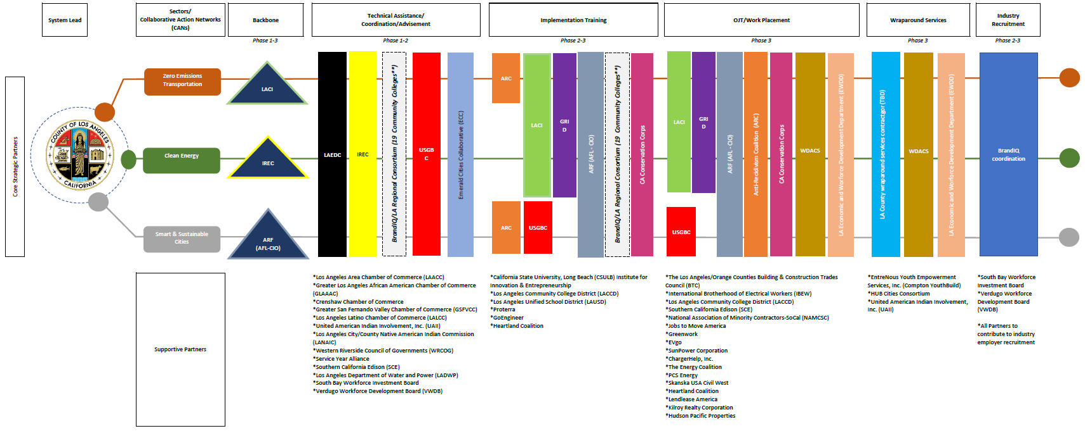
partnership model.

Slide 19
grant proposal phases.

Slide 20
Contacts
County of Los Angeles
Internal Services Department (ISD) Office of Energy & Environmental Service (EES)
Department of Workforce Development, Aging and Community Services (WDACS)
Kelly LoBianco
Executive Director
WDACS
(213) 880-4114
klobianco@wdacs.lacounty.gov
Minh S. Le
General Manager
ISD-EES
(323) 267-7006
MSLe@isd.lacounty.gov
Lujuana Medina
Environmental Initiatives Manager
ISD-EES
(323) 881-3971
LMedina@isd.lacounty.gov
Sheena Tran
Program Manager
ISD-EES
(562) 413-1808
STran2@isd.lacounty.gov

Slide 21
WE&T Portfolio of Programs 2021 Updates

Slide 22
The County of Los Angeles/Southern California Regional Energy Network (SoCalREN) was created to harness the collective power of residents, businesses, and the public sector to achieve an unprecedented level of energy savings across Southern California.
Public Agencies
Residential
Financing
WE&T
OBJECTIVES:
Provide comprehensive solutions to Public Agencies and their surrounding communities.
Build an effective, flexible, and collaborative program structure for local governments.
Leverage external resources to provide services and resources beyond energy efficiency.
Become a cost-efficient leader.

Slide 23
CURRENT SOCALERN WE&T Sector Program Structure
Workforce Education and Training Sector
Offerings
Sub-Program
E-Contractor
ACES Pathway Program
Green Path Career Program
Multifamily
IOU
Public Sector
Dual Enrollment
Paid Internships
BPI Certification
Paid Work Experience
E-Contractor Academy
Skills Certificates
Work Experience
SOLIDWORKS Industry Certification
Coaching

Slide 24
E-Contractor Program

Slide 25
E-Contractor Training Program
Program Description & Objective
The E-Contractor Training Program is designed to prepare small and diverse contractors to compete for energy efficiency projects and increase their capacity.
Program Offerings
Host workshops to increase MWDVBEs basic information and knowledge
One-on-One technical assistance and workshops to increase contractors’ access to capital, bonding and insurance
Participants receive training options, certificated programs, access to construction technologies, and equipment/materials
One-on-One technical assistance and RFP development

Slide 26
Program Updates
2021 Training
6 workshop trainings
114 contractors
Enrollment
Technical Assistance and one-on-one coaching
44 contractors
Certification assistance
Capability statement
Bonding
Agency Pre-Qualification

Slide 27
Green Path Careers
Program Overview

Slide 28
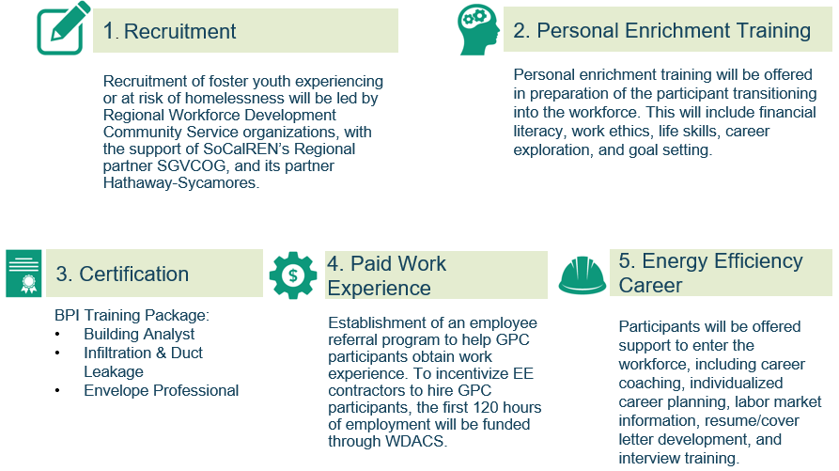
Program Model
Notes:
So the goal of this program is to help the transitioning aged youth into a career pathway in the growing energy efficiency sector and begin a thriving career.
We are targeting this classified population because we know they face more barriers when entering the work field in general and this program will help to eliminate some of those barriers.

Slide 29
Program Updates
Enrollment
Cohort 1
Transitioned Aged Youth (TAY)
10 participants
2 participants passed BPI examination
Participants placed with employer partner
The Energy Coalition
Cohort 2
Justice Impacted individuals
Ages 25 and over
7 participants
2 participants passed BPI examination
Receiving case management support

Slide 30
ACES Pathway Program
Notes:
DWP develop contractor focus, no ACES no GPC

Slide 31
Program Description & Objective
To engage, expose and challenge students to explore architecture, engineering and construction careers by capitalizing on public works investment, community college STEAM course offerings and strong industry participation.
Program Offerings
Outreach/recruitment will be done each semester in coordination with the high schools and community colleges
Identify entry level opportunities in ACE high road careers and match participants with paid internships
Offer paid industry accepted certificate training every summer
Provide access to technology, transportation and clothing
Notes:
The mission of the program is to expose disadvantaged students to Architecture construction and engineering with an emphasis on Energy Efficiency.
Most of the current schools we work with are classified as Title I with most students receiving free or reduced lunch which means that it is predominantly low income community.

Slide 32
Program Updates
New Community College Partnership
LA Mission College
2 San Fernando Valley HS
Spring 2022 course start
2021 Enrollment
Spring 2021 - Fall 2021
149 students enrolled in community college dual enrollment courses
Summer Paid Internship
23 students participated virtually and in-person
3 employer partners
IMEG
SKANSKA
CNC Engineering
SOLIDWORKS
6 individual students passed CSWA including:
Sustainability
Manufacturing

Slide 33
SoCalREN 2024-2031 Business Plan
Expanding Resources for Existing and New WE&T Programs

Slide 34
Workforce Education & Training Summary
Existing Sector
WE&T Sector
Why is SoCalREN offering this sector?
DAC/HTR communities face unique challenges and barriers to enter the EE sector
Designed to target and strengthen DAC/HTR participants specifically in order to create labor/worker pipeline to meet supply and demand
Meeting the CPUC’s foci on supplier diversity (GO 156), increasing women-owned, minority-owned, disabled veteran-owned and LGBT-owned business enterprises' (WMDVLGBTBEs) procurement in all categories.
What are the gaps that SoCalREN will be filling in the WE&T Sector?
Increased EE resources for hard-to-reach (HTR) and disadvantaged communities (DAC)
Reduce labor Shortage in EE/construction/smart building technologies
Increase BIPOC residents and businesses with skills, jobs & business opportunities in green building technologies/high performance buildings
Reduce fragmented and misaligned workforce and small business ecosystem to support EE/RE through the Regional Workforce Alliance
SoCalREN WE&T Accomplishments to-date
Over 440 contractors trained
Over 1,000 students enrolled in educational trainings
Over 190 paid internships awarded

Slide 35
WE&T Program List and Proposed Budgets
WE&T Sector
The total authorized 2022-2023 budget is $1,550,000
Program Name | New or Existing Program | Business Plan Proposed Budget 2024-2031
ACES | Existing | $4,907,805
Green Path Careers | Existing | $8,144,590
WE&T HUB | New | $5,636,213
E-Contractor Academy | Existing | $4,552,550
WE&T Agriculture | New | $2,461,530
Total |  | $25,702,688

Slide 36
WE&T Opportunity HUB
New Program
WE&T Sector
Program Description and Objective
The WE&T Opportunity Hub is a one-stop shop (virtual and physical) community resource providing high visibility and access to energy efficiency (EE) consumer information, training, and networking opportunities.
Program Offerings
Participants receive access to support services from partners such as technology, transportation, or clothing.
Participants receive help with capital, bonding, and insurance. The program goal is to partner with banks, CDFIs, and other associations to assist with the barrier.
Participants informed through outreach measures set in place.
The development of a shared online platform/brokerage system for skilled workers and contractors to identify jobs and contracting opportunities.
Participants receive ongoing training in new building codes, construction materials and equipment, project management software and estimating technologies, labor standards, construction administration, and project delivery methods (for example, P3s).
Partnership alliance agreements with industry, community, and institutional partners to collectively address barriers to entry and growth and define strategies to maximize economic opportunity for communities of color.

Slide 37
WE&T Agriculture
New Program
WE&T Sector
Program Description and Objective
The SoCalREN Agriculture Energy Efficiency Workforce, Education and Training (Ag-WE&T) aims to achieve the following objectives:
Expand the implementation of cost-effective energy efficiency projects;
Build the trade ally network of qualified Ag service providers;
Train Ag trade allies on how to “sell” an energy efficiency product in the various Ag sectors;
Make energy efficiency expertise accessible and available; and
Integrate energy efficiency as a standard business practice for Agriculture customers.
Program Offerings
Host workshops to increase MWDVBEs basic information and knowledge
One-on-One technical assistance and workshops to increase contractors’ access to capital, bonding and insurance.
Participates will receive training options, certificated programs, access to construction technologies, and equipment/materials.
One-on-One technical assistance and RFP development

Slide 38
Next Steps
Regional Workforce Alliance meets bi-annually
Create Alignment Strategy

Slide 39
Closing Remarks

