Slide 1
We’ll be starting shortly...
Regional Workforce Alliance
Quarter 3
Note to Participants:
If you experience any difficulty connecting via Zoom at any time during the webinar please contact Wendy Angel at:
wangel@emeraldcities.org

Slide 2
Regional Workforce Alliance Q3
Wednesday, November 16, 2022

Slide 3
Welcome
Minh Le
General Manager
Energy and Environmental Services
Los Angeles County, ISD
Lujuana Medina
Environmental Initiatives Manager
Energy and Environmental Services
Los Angeles County, ISD

Slide 4
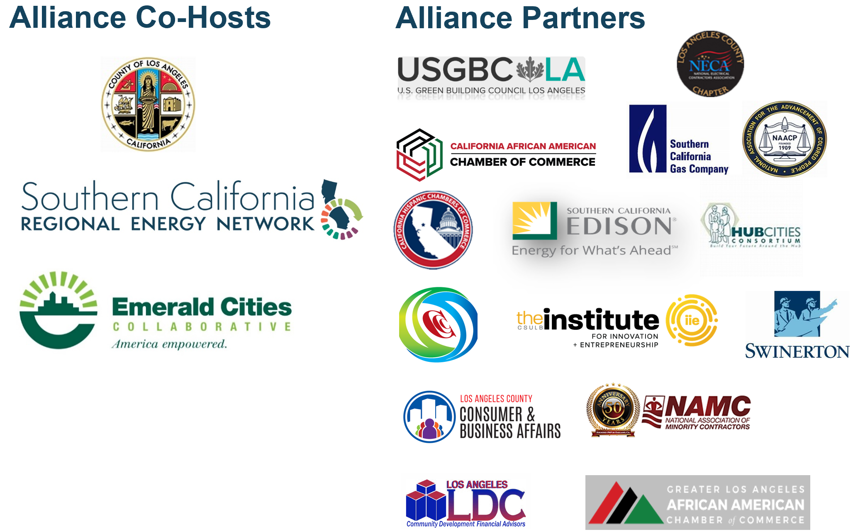


Slide 5
Agenda
1:00 Welcome
1:05 Introductions
1:10 County of Los Angeles, Department of Economic Opportunity
1:20 New Partner Introduction: PACE
1:30 Future Green Leaders Youth Summit
1:40 E-Contractor Program Updates
1:45 Regional Workforce Alliance Updates
1:50 Open Discussion
2:00 Closing Remarks

Slide 6
Mission Statement & Goals for the Alliance

Slide 7
Mission:
Provide disadvantaged communities with equitable access to training and employment opportunities generated by investments in energy efficiency.
Goal:
Harness and coordinate the resources of industry, academic institutions and community-based organizations to develop a regional clean energy economic inclusion capacity building infrastructure to help meet the demand for skilled workers and contractors in the energy sector, with a specific focus on residents and businesses in disadvantaged communities.

Slide 8
County of Los Angeles, Department of Economic Opportunity

Slide 9
PACE

Slide 10

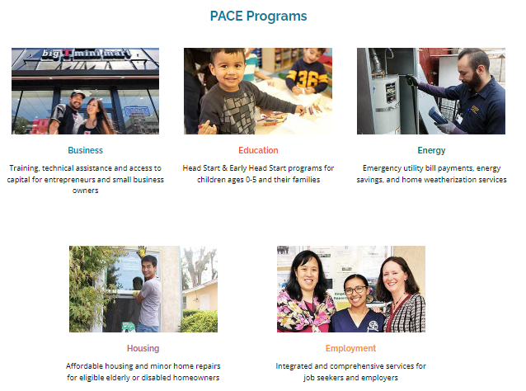
Non-profit organization founded in 1976
PACE is a community development organization that annually serves over 40,000 low-income residents of the Los Angeles area by creating economic solutions to meet the challenges of employment, education, housing, the environment, and business development in the Pacific Asian and other diverse communities.

Slide 11









Founded after the Los Angeles’ 1992 civil unrest
PACE Business Development Center is a local, non-profit organization that aims to advance the wealth of our communities. We give individuals the tools to develop sustainable businesses and successfully manage their personal finances.
Programs under PACE Business Development Center:
City of Los Angeles BusinessSource Center for the Central West & Mid-City Region
Designated SBA Women's Business Center (WBC)
Certified U.S. Treasury Community Development Financial Institution (CDFI)
U.S. Small Business Administration (SBA) Microloan Intermediary
Minority Business Development Agency (MBDA)
Office of Refugee Resettlement – Microenterprise Development (ORR - MED)
GoBiz
National CAPACD

Slide 12
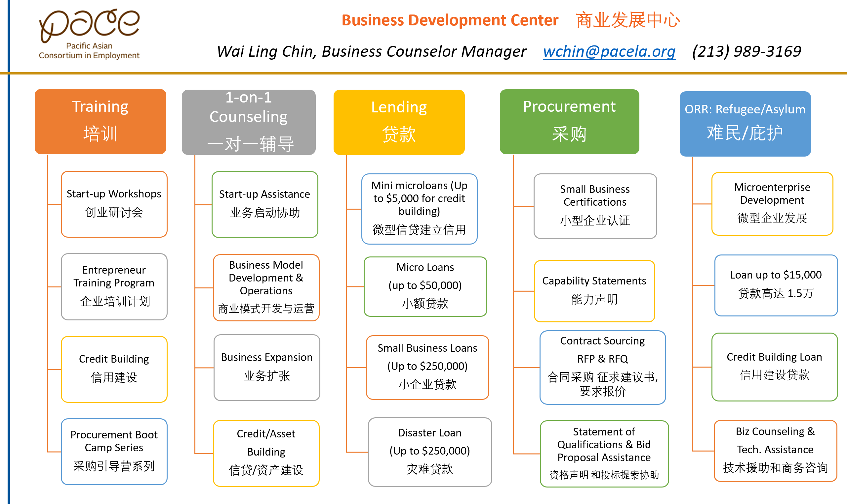
PACE 1055 Wilshire Blvd, Suite 900 B, Los Angeles, CA 90017
Tel: (213) 353-9400 Fax: (213) 353-4665 www:pacela.org www:pacelabdc.org

Slide 13

Virtual Regional Workforce Alliance Meeting
November 16, 2022
Presented by
Wai Ling Chin
Business Counselor Manager
PACE Business Development Center
Direct line: (213) 989-3169
Email: wchin@pacela.org
1055 Wilshire Blvd. Suite 900B, Los Angeles, CA 90017

Slide 14



SoCalREN Workforce Education & Training Program

Slide 15

about the event.
A day event in LA for students to learn about different career pathways in Sustainability and Energy Efficiency they may not be introduced to otherwise.
Event Goals
Introduce and expose students to a variety of careers in sustainability and energy efficiency by hosting a day of activities and speakers
Reach 3,000–5,000 students from 130–150 classrooms
Target Audience
Middle school students
(7th–8th grade students)
Primarily from disadvantaged, HTR,
low-income communities
FUTURE GREEN LEADERS SUMMIT • 2022

Slide 16

objective.
To engage, expose and challenge students from low income and disadvantaged communities to explore the Energy/Green Sector, one of the country’s fastest growing job markets. The lack of role models and support from parents and teachers has only led to 42% of young girls to be knowledgeable in pursuing STEM careers.
Program data insight found that students lose interest once older because of the lack of interaction with mentors in the STEM field as well as the lack of available curriculum for teachers.
FUTURE GREEN LEADERS SUMMIT • 2022

Slide 17

activities and offerings.
Tour guide for each group of students
Workshops: hands-on activities related to energy sector career pathways
Women in energy panel and keynote speakers
1:1 mentorship opportunities with industry experts
Resource fair: employer partners, resources, and many more exhibitors
FUTURE GREEN LEADERS SUMMIT • 2022

Slide 18
E-Contractor Program Updates

Slide 19
E-Contractor Program

Slide 20
E-Contractor Training Program
Program Description & Objective
The E-Contractor Training Program is designed to prepare small and diverse contractors to compete for energy efficiency projects and increase their capacity.
Program Offerings
Host workshops to increase MWDVBEs basic information and knowledge
One-on-One technical assistance and workshops to increase contractors’ access to capital, bonding and insurance
Participants receive training options, certificated programs, access to construction technologies, and equipment/materials
One-on-One technical assistance and RFP development

Slide 21
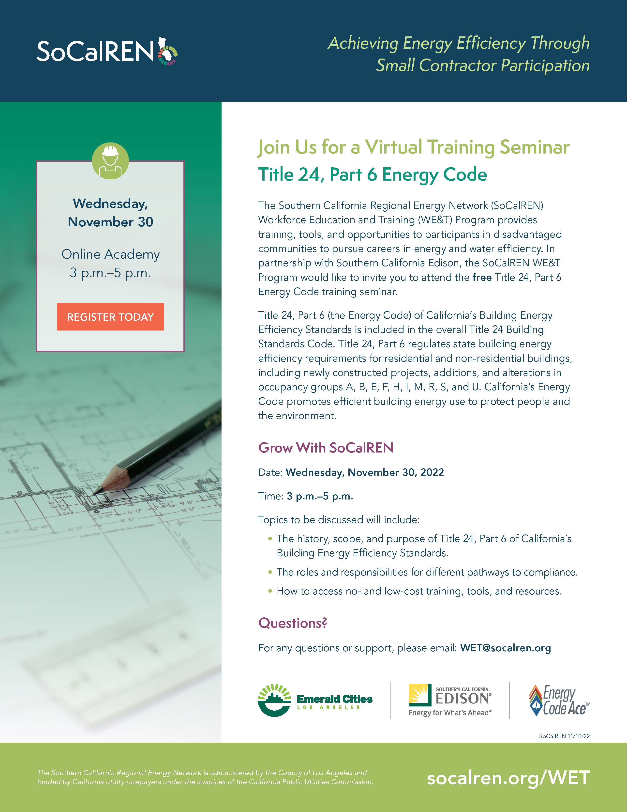


Program Updates
Program Timeline
  Title 24
    November 30
Program Enhancements
  Level 3 Academy
    Estimating
9 Workshops
231 Contractors

Slide 22
RWA Updates and Next Steps

Slide 23
RWA Updates
Website
Quarterly Meetings

Slide 24
Closing Remarks

