Slide 1
We’ll be starting shortly...
Regional Workforce Alliance
Quarter 2
Note to Participants:
If you experience any difficulty connecting via Zoom at any time during the webinar please contact Wendy Angel at:
wangel@emeraldcities.org

Slide 2
Regional Workforce Alliance Q2 Wednesday, July 27, 2022

Slide 3
Welcome
Minh Le
General Manager
Energy and Environmental Services
Los Angeles County, ISD
Lujuana Medina
Environmental Initiatives Manager
Energy and Environmental Services
Los Angeles County, ISD

Slide 5
Agenda
12:00 Welcome
12:05 Introductions
12:10 EDA Good Jobs Challenge Grant Update
12:15 Partnership Map
12:25 SoCalREN Program Updates
12:35 Justice 40
12:50 Open Discussion
12:55 Next Steps
1:00 Closing Remarks

Slide 6
Meeting Objectives
Launch regional multi-stakeholder alliance to create career and business pathways into the Energy Efficiency sector
Identify areas to:
Guide & Advise
Collaborate & Innovate
Be Informed
Be an Advocate

Slide 7
Mission Statement & Goals for the Alliance

Slide 8
Mission:
Provide disadvantaged communities with equitable access to training and employment opportunities generated by investments in energy efficiency.
Goal:
Harness and coordinate the resources of industry, academic institutions and community-based organizations to develop a regional clean energy economic inclusion capacity building infrastructure to help meet the demand for skilled workers and contractors in the energy sector, with a specific focus on residents and businesses in disadvantaged communities.

Slide 9
Activities & Initiatives

Slide 10
EDA Good Jobs Challenge Grant Update

Slide 11
Partnership Map

Slide 12
Partnership Map
Interactive Map
Based on Survey Responses
https://www.surveymonkey.com/r/6KQKQ6Y
Google Pin Map

Slide 13
Workforce Education and Training Updates

Slide 14
The County of Los Angeles/Southern California Regional Energy Network (SoCalREN) was created to harness the collective power of residents, businesses, and the public sector to achieve an unprecedented level of energy savings across Southern California.
Public Agencies
Residential
Financing
WE&T
OBJECTIVES:
Provide comprehensive solutions to Public Agencies and their surrounding communities.
Build an effective, flexible, and collaborative program structure for local governments.
Leverage external resources to provide services and resources beyond energy efficiency.
Become a cost-efficient leader.

Slide 15
CURRENT SOCALERN WE&T Sector Program Structure
Workforce Education and Training Sector
Offerings
Sub-Program
E-Contractor
ACES Pathway Program
Green Path Career Program
Multifamily
IOU
Public Sector
Dual Enrollment
Paid Internships
BPI Certification
Paid Work Experience
E-Contractor Academy
Skills Certificates
Work Experience
SOLIDWORKS Industry Certification
Coaching

Slide 16
E-Contractor Program

Slide 17
E-Contractor Training Program
Program Description & Objective
The E-Contractor Training Program is designed to prepare small and diverse contractors to compete for energy efficiency projects and increase their capacity.
Program Offerings
Host workshops to increase MWDVBEs basic information and knowledge
One-on-One technical assistance and workshops to increase contractors’ access to capital, bonding and insurance
Participants receive training options, certificated programs, access to construction technologies, and equipment/materials
One-on-One technical assistance and RFP development

Slide 18
E-Contractor Program
22
150
85
30
1 Workshop
Contractors Trained
Technical Assistance/ Coaching
Q3 and Q4:
E-Contractor Level 2 Academy
5 Sessions
Cohort Goal: 35
Individual Workshops:
Title 24
Access to Capital
RES MF
LCPtracker
Certification Workshop:
GPRO Session 1 and 2
177
forecast

Slide 19
Green Path Careers
Program Overview

Slide 20
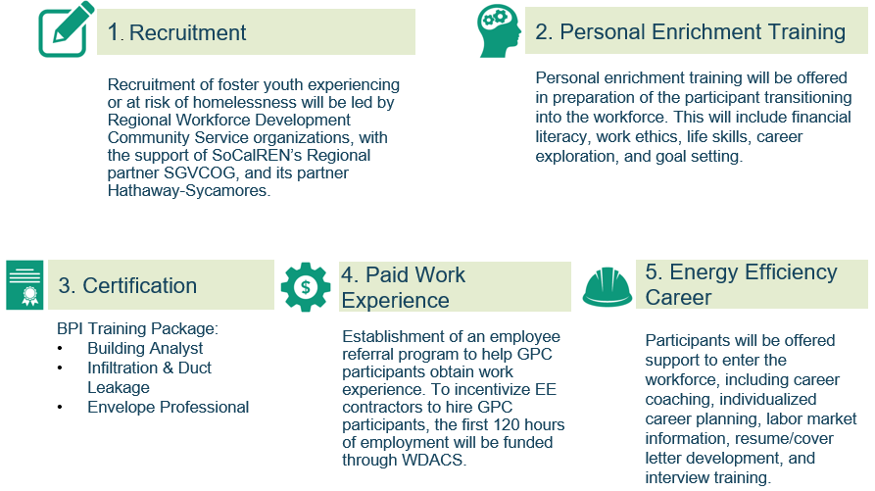
Program Model
Notes:
So the goal of this program is to help the transitioning aged youth into a career pathway in the growing energy efficiency sector and begin a thriving career.
We are targeting this classified population because we know they face more barriers when entering the work field in general and this program will help to eliminate some of those barriers.

Slide 21
Green Path Careers Program
Q3 and Q4:
New Partnerships:
City of Lancaster
A New Way of Life
East LA/WSGV AJCC
Employer Feedback
40
23
Case Management Support
Cohort 3: 15
Cohort 4: 8

Slide 22
ACES Pathway Program
Notes:
DWP develop contractor focus, no ACES no GPC

Slide 23
Program Description & Objective
To engage, expose and challenge students to explore architecture, engineering and construction careers by capitalizing on public works investment, community college STEAM course offerings and strong industry participation.
Program Offerings
Outreach/recruitment will be done each semester in coordination with the high schools and community colleges
Identify entry level opportunities in ACE high road careers and match participants with paid internships
Offer paid industry accepted certificate training every summer
Provide access to technology, transportation and clothing
Notes:
The mission of the program is to expose disadvantaged students to Architecture construction and engineering with an emphasis on Energy Efficiency.
Most of the current schools we work with are classified as Title I with most students receiving free or reduced lunch which means that it is predominantly low income community.

Slide 24
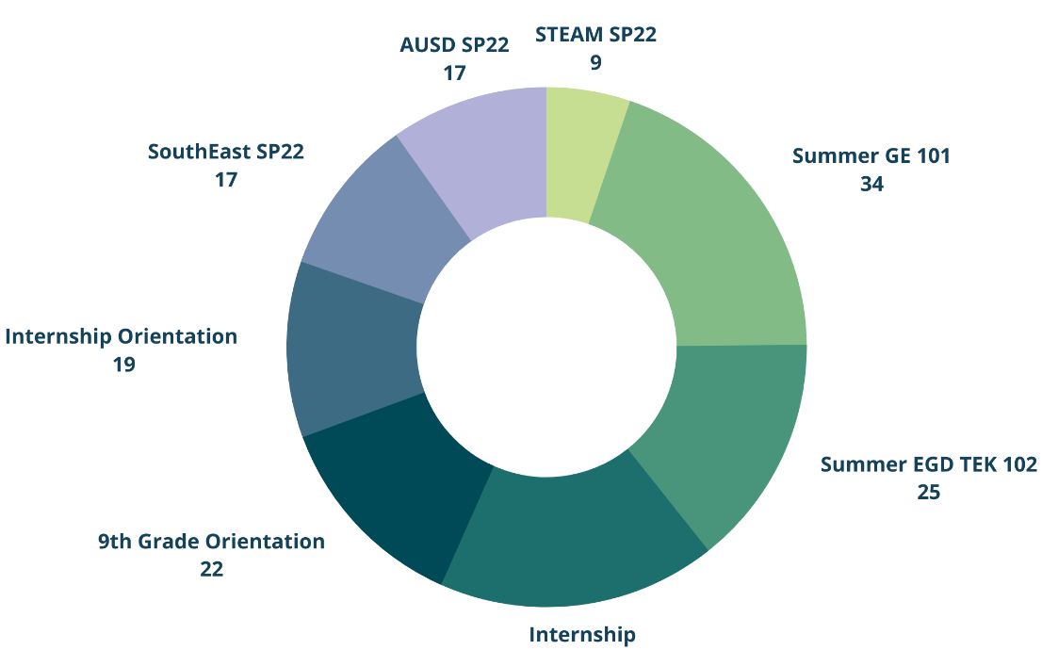
ACES Pathway Program
Q3 and Q4:
Fall 2022
Verdugo Hills HS (SFV)
2 Courses
San Bernardino County
DAC HS Identified
Fontana HS 93%
Indian Springs HS 93%
San Bernardino HS 92%
Adelanto HS 86%
Sherman Indian HS
Riverside County
Noli Indian HS
173
240 Goal

Slide 25
Justice40

Slide 26
What is the Justice40 Initiative?
Justice40 is a Federal Initiative
GOAL: 40% of overall benefits of certain federal investments flow to disadvantaged communities
Federal Investments:
Clean Energy and Energy Efficiency
Clean Transit
Affordable and Sustainable Housing
Training and Workforce Development
Remediation and Reduction of Legacy Pollution
Development of Clean Water Infrastructure

Slide 27
Justice40 Interim Implementation
Benefits: include direct and indirect investments (and program outcomes) that positively impact disadvantaged communities
Disadvantaged Communities: Climate and Economic Justice Screening Tool
California’s AB2419 - Environmental Justice: Federal IIJA: Justice40 Advisory Committee

Slide 28
Emerald Cities: The People’s Justice40+ Community Benefits Playbook
What is Justice 40?
Why a Community Benefit Playbook?
Show Me the Money: Guide to Federal Spending Bills
The Energy Justice Playbook
The Water Justice Playbook
The Economic Justice Playbook
The Environmental and Climate Justice Playbook
The Transportation Equity Playbook (forthcoming)
Community Benefit Plans: From Policy to Community Impact

Slide 29
LA Justice40+ Alliance

Slide 30
LA Justice40+ Alliance
Purpose: Ensure community readiness, engagement, and decision making for when IIJA/J40 resources come to the state and city level
Goal: Empower a community-driven and -designed Community Benefits Plan, including workforce and business development benefits, for L.A.-based infrastructure policies, programs and investments
Activities:
Monthly, multi-stakeholder convening and strategy sessions
Monthly newsletter for federal updates and analyses in between strategy sessions
LA-specific resource development and analysis, supported by Equity Fund
Technical assistance from community policy practitioners, supported by Justice Solutions Collective

Slide 31
Next Steps
Regional Workforce Alliance Q3 Meeting
Create Alignment Strategy

Slide 32
Closing Remarks

