Slide 1

welcomes you to help Fuzzy with his monster mission!

Slide 2

Introduction to Energy
Objectives
  Students will be able to:
  Identify how energy
  is used in everyday life.
  Understand the differences between energy conservation, efficiency, and resiliency.
  Identify ways people can make smart energy choices at home.
Agenda
Listen to Fuzzy’s Bright Ideas.
Play Fuzzy’s Resilient Energy Adventure game.
Review energy topics.
Receive energy kits.

Slide 3

Warm-Up
What are some items that use energy at home or school?
Answer question #1 on your worksheet.
Notes:
Energy is what things use to do their job — move, heat, cool, light up, and power screens and devices.
Examples:
• Air Conditioner - Using energy can help us stay comfortable on hot days.
• Lights – Using energy can help us see and do things when there is no sunlight.
• Microwave, oven, air fryer, toaster, etc. – Using energy helps us warm our food and prepare meals.
• Refrigerator, freezer – Using energy helps us preserve food so it stays safe to eat for longer.
• TV, game systems, computers, audio devices, phones, clocks – Using energy helps us take photos and videos, look things up, keep time, stay connected over distances, and entertain ourselves.

Slide 4

Discuss
What might cause a refrigerator use more or less energy?
(Hint: Think about a refrigerator’s job.)
What might make that job easier or harder?
Notes:
The fridge’s job to keep things cold so we can preserve food, making it safe to eat for longer periods of time.
Things that Affect a Refrigerator's Energy Use:
• Whether you’re putting hot, room temperature, or cold food in it.
• If you put food inside that is still very warm, the hot food raises the overall temperature inside the fridge, meaning it needs more energy to cool down again.
• Whether or not you are leaving the door open.
• Leaving the door open allows room temperature air inside and the colder air to escape.
• How full the fridge is.
• More items that are already cold inside the fridge means less extreme fluctuations in temperature when unchilled items are placed inside the fridge or the door is opened.
• Whether or not it’s an energy efficient appliance.
• Energy efficient appliances are designed to do the same job using less energy.

Slide 5
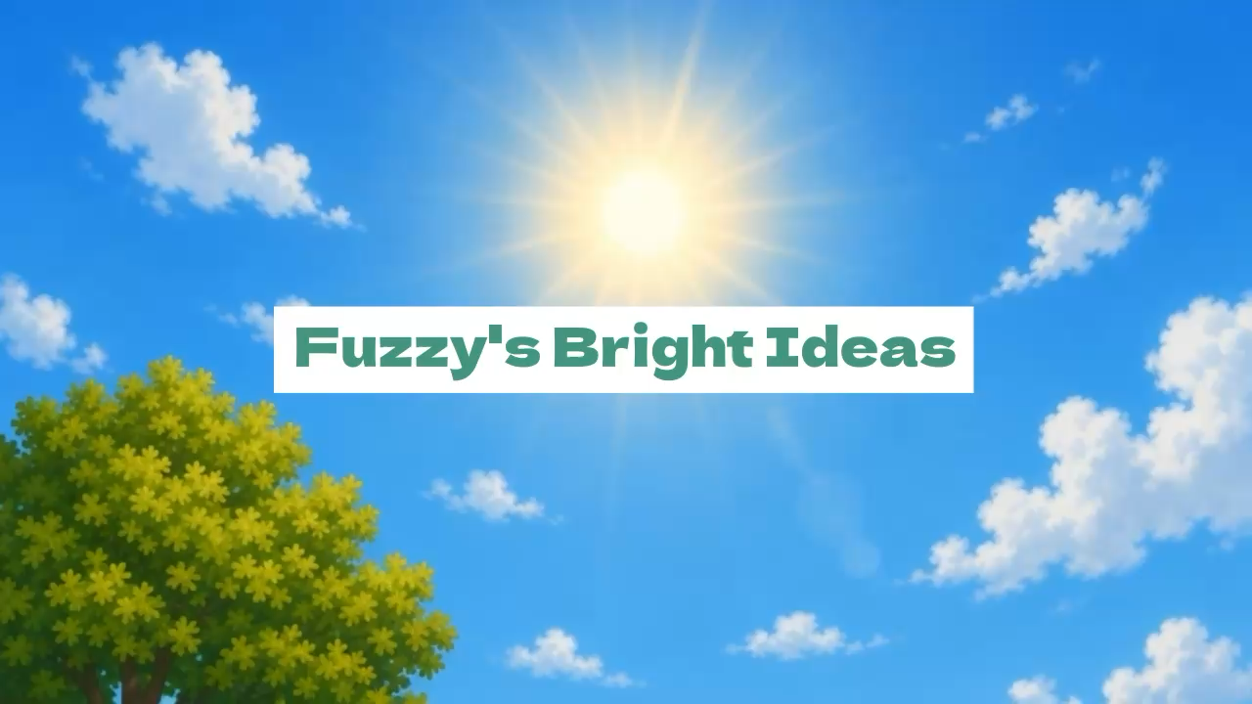
FPO
Notes:
Select to Play the video.

Slide 6

To conserve means to use something carefully and avoid wasting it.
What are three different ways you conserve energy at home?
Example: you keep the refrigerator door closed when you’re not using it.
Answer question #2 on your worksheet.
Notes:
To conserve means to use something carefully and avoid wasting it.
For example, you can use less energy by closing the refrigerator door right away.

Slide 7
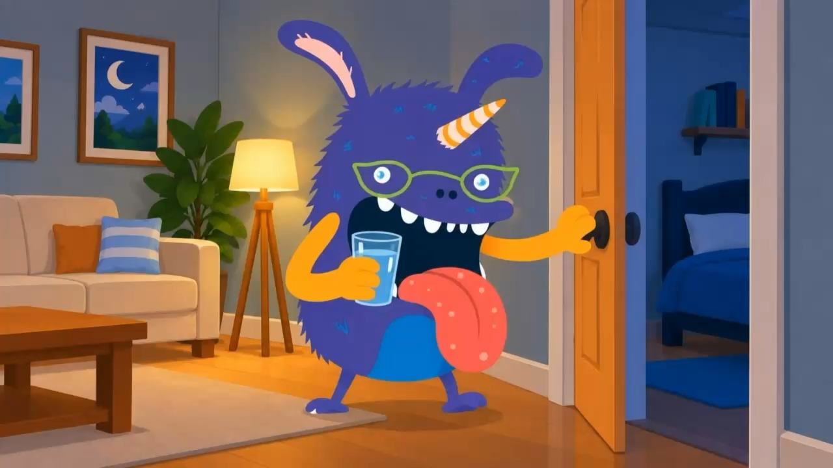
FPO
Notes:
Select to Play the video.

Slide 8
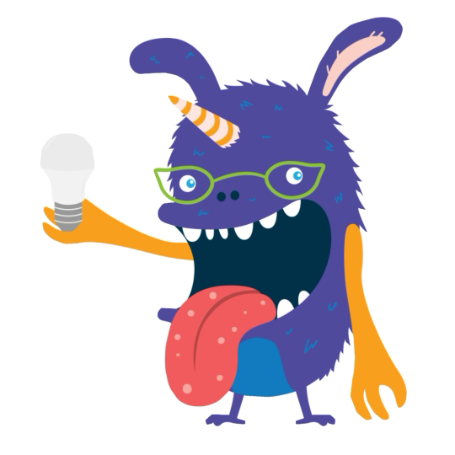
An item that is energy efficient takes less energy to do the same job.
Cool! Have you heard of LED bulbs?
LED bulbs use less energy than other bulbs. Plus, they last 15 times longer than other bulbs!
People who use LED bulbs save energy and money.
Source: energystar.gov/sites/default/files/asset/document/Certified%20Light%20Bulbs%20at%20a%20Glance_04-17-2020.pdf
Notes:
The LED lightbulb provides the same amount of light as the old bulb but uses less energy. Energy-efficient describes something that does the same job but uses less energy.
Efficient: Describes something that does the same job with less waste.
Energy-efficient comparison: Both bulbs provide light, but the LED needs less energy to do it.

Slide 9
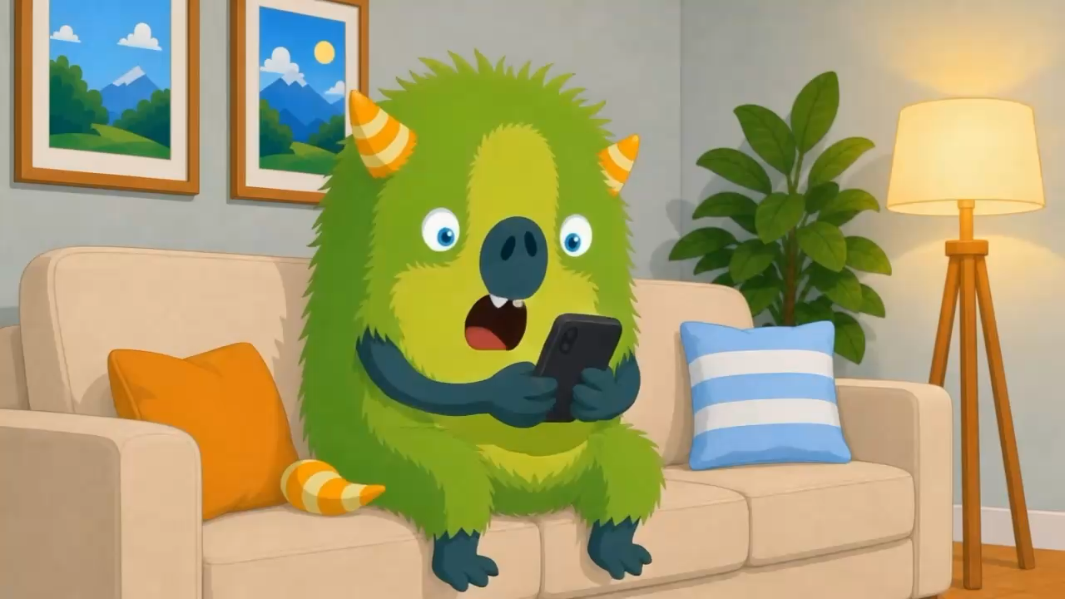
FPO
Notes:
Select to Play the video.

Slide 10
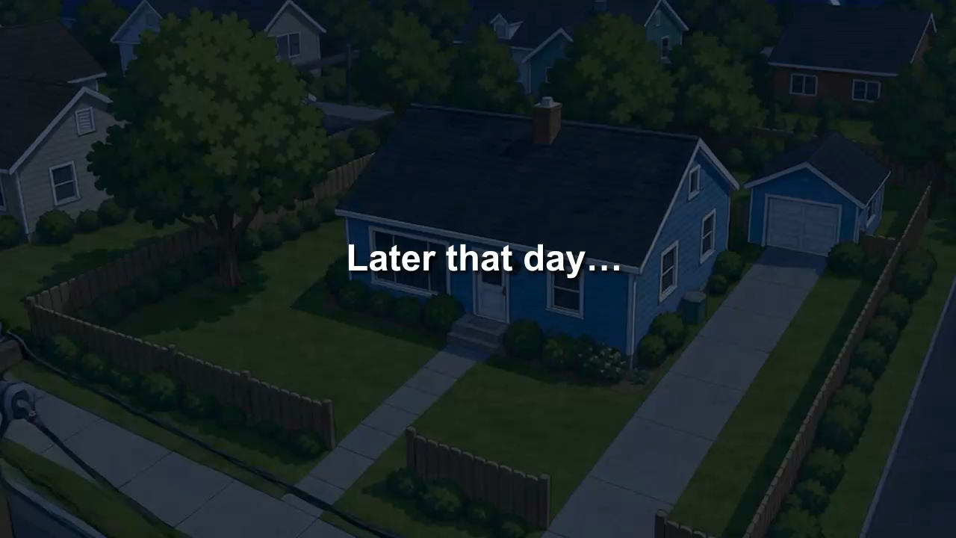
FPO
Notes:
Select to Play the video.

Slide 11
Being resilient means being prepared to handle a difficult change.
In the story, what did Fuzzy and Specter do to be resilient before and during the power outage?
Answer questions #3 and #4
on your worksheet.
Notes:
Instruct students to answer questions 3 and 4 in the Activity Sheet.

Slide 12
Being resilient means being prepared to handle a difficult change.
In the story, what did Fuzzy and Specter do to be resilient before and during the power outage?
  Learned how to make smart energy choices.
  Charged their technology
  when they received phone alert.
  Gathered a flashlight.
  Stayed calm and followed their plan.
Notes:
Review student responses to questions 3 and 4.

Slide 13
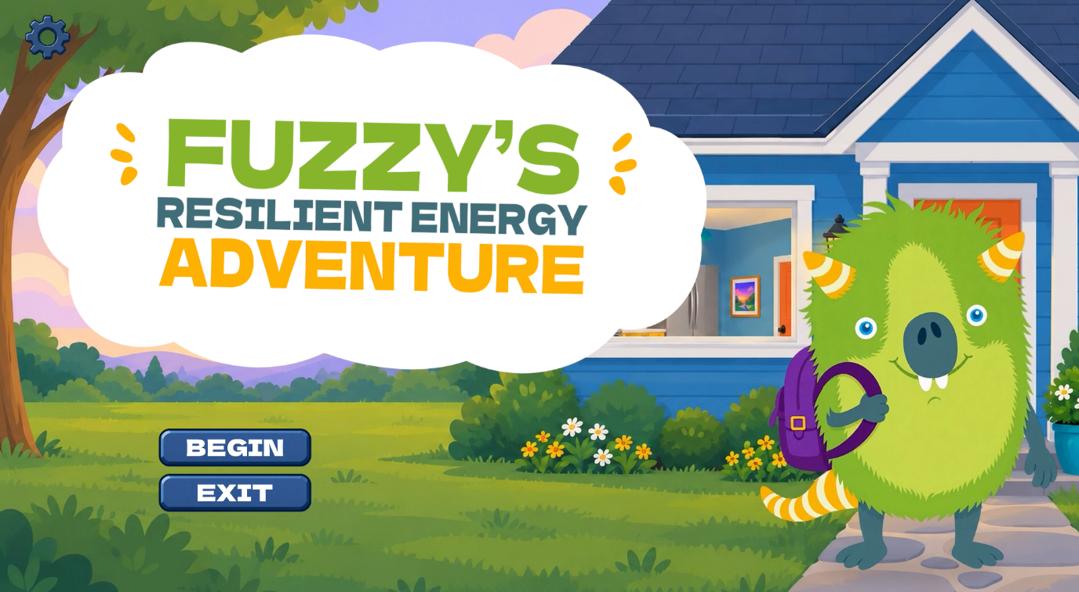
Fuzzy’s Resilient Energy Adventure
A new game is coming soon
to accompany the new kit!
In the meantime, check out these games to learn more about energy efficiency here.
Notes:
The game will open in your internet browser. When finished, exit the browser to return to your PowerPoint presentation.

Slide 14


Mission Accomplished!
You did a great job working
together to help Fuzzy make
smart energy choices!
Let’s review what we learned today.

Slide 15
Energy Review
Energy ________ is the ability to be prepared when energy is unavailable, such as during
a power outage.
Energy ________ is the use of habits
and choices that reduce energy waste.
Energy ___________ is the choice to use devices that need less energy to do the same job.
WORD BANK
Efficiency
Conservation
Resilience
Notes:
Instruct students to complete the Energy review portion of the Activity Sheet.

Slide 16
Energy Review
Energy resilience is the ability to be prepared when energy is unavailable, such as during
a power outage.
Energy ________ is the use of habits
and choices that reduce energy waste.
Energy ___________ is the choice to use devices that need less energy to do the same job.
WORD BANK
Efficiency
Conservation
Resilience
Notes:
Review student answers.

Slide 17
Energy Review
Energy resilience is the ability to be prepared when energy is unavailable, such as during
a power outage.
Energy efficiency is the use of habits
and choices that reduce energy waste.
Energy ___________ is the choice to use devices that need less energy to do the same job.
WORD BANK
Efficiency
Conservation
Resilience
Notes:
Review student answers.

Slide 18
Energy Review
Energy resilience is the ability to be prepared when energy is unavailable, such as during
a power outage.
Energy efficiency is the use of habits
and choices that reduce energy waste.
Energy conservation is the choice to use devices that need less energy to do the same job.
WORD BANK
Efficiency
Conservation
Resilience
Notes:
Review student answers.

Slide 19

Great job!
Remember, today’s
smart energy choices build a strong and resilient community for tomorrow.
Notes:
Small actions students and families take today—saving energy, using efficient products, preparing for disruptions, and working together—add up to a stronger, more resilient community tomorrow.

Slide 20
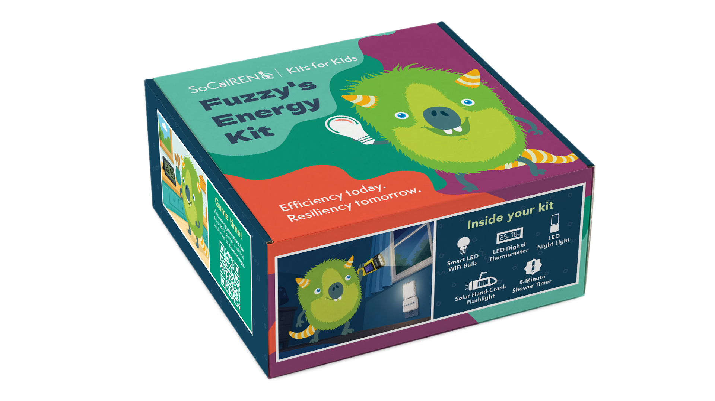
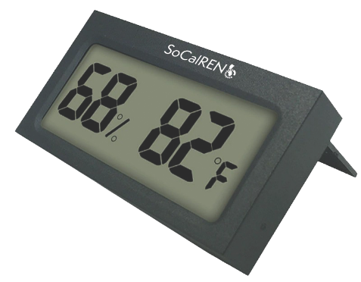
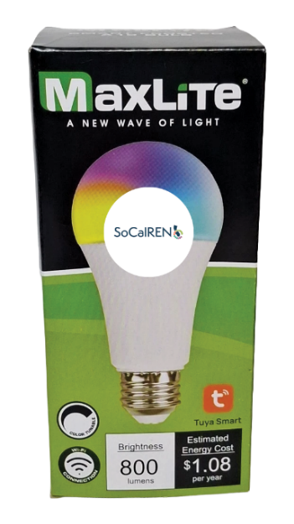
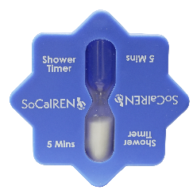
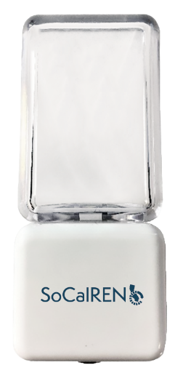
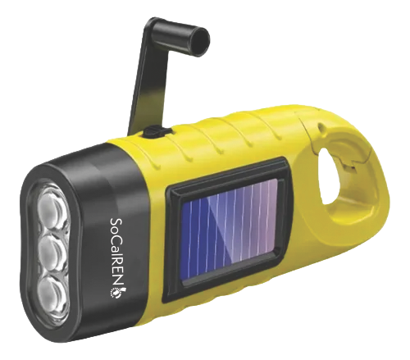
Fuzzy’s Energy Kit
You get to take home
Fuzzy’s Energy Kit today!
Your kit has each of the resilient and energy-efficient items you helped Fuzzy use to defeat the Energy Eaters, so you can help your family save energy and be energy resilient at home!

Slide 21
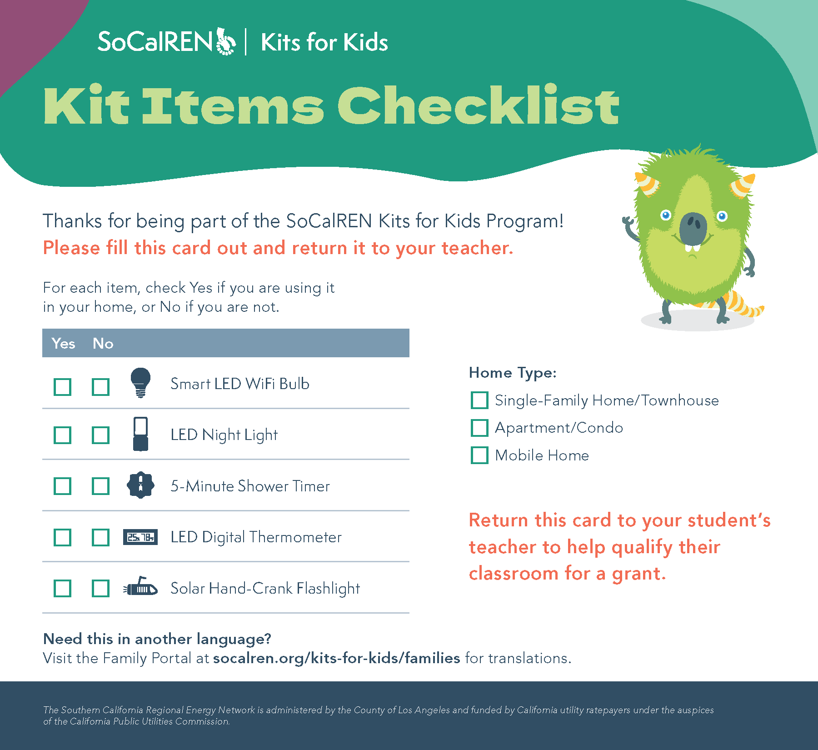
Thanks for helping Fuzzy
on his monster mission!
When you go home, get an adult to help you unpack and use your kit items. Then, fill out and return the card inside the kit to your teacher.
You could help your class get $1,000!*
*A $500 grant will be offered to classrooms of 10 students or less. Grant eligibility
is dependent on availability of funds. No personal identifying information is collected.

