Slide 1
Kits for Kids welcomes you to help Fuzzy and Specter on their monster missions to help the environment!
Notes:
Hi, Class! How’s everyone doing today? (Pause for responses) Awesome! My name is Mr. O'Neal, but you can call me Ryan. Today, we’re going to learn how to be Super Energy Savers! We’ll answer some fun questions, play games, and even get some special gifts!
But first, we have a few simple rules:

Slide 2

Kits for Kids Program
Objectives
Students will be able to:
Define “energy efficiency” and “climate resiliency”
Identify ways to be energy efficient and climate resilient
Agenda
Introduction to energy efficiency
Fuzzy’s monster mission game
Introduction to climate resiliency
Specter’s monster mission game
Energy efficiency and climate resiliency review
Kit handout
Notes:
Cancel this slide!!!!!!!!

Slide 3
Fuzzy’s Mission
I’m on a mission to save energy!
Notes:
Hi, Class! How’s everyone doing today? (Pause for responses) Awesome! My name is Mr. O'Neal, but you can call me Ryan. Today, we’re going to learn how to be Super Energy Savers! We’ll answer some fun questions, play games, and even get some special gifts!
But first, we have a few simple rules:

Slide 4

Warm Up
What are some things at home that use energy?
Take a minute and write down your ideas.
Hint: Think about the things that are plugged in at your home.
Notes:
Use word bank questions;
Energy efficiency: what is energy? Draw picture or write it down
Ex.. Phone and phone charger

Slide 5

Lamps use energy!
For a lamp to work, you need to screw in a light bulb and plug it in.
Did you know? There’s a type of light bulb that can help you save energy and money at home. Any guesses?
Notes:
Use word bank questions;
Energy efficiency: what is energy? Draw picture or write it down
Ex.. Phone and phone charger

Slide 6

An LED Bulb!
LEDs use less energy than other bulbs.
Plus, they last 15 times longer than other bulbs! You can find an LED bulb in your kit. When installed, you’re helping your family save energy and money.
Source: energystar.gov/sites/default/files/asset/document/Certified%20Light%20Bulbs%20at%20a%20Glance_04-17-2020.pdf
Notes:
Use word bank questions;
Energy efficiency: what is energy? Draw picture or write it down
Ex.. Phone and phone charger Source: https://www.energystar.gov/sites/default/files/asset/document/Certified%20Light%20Bulbs%20at%20a%20Glance_04-17-2020.pdf

Slide 7
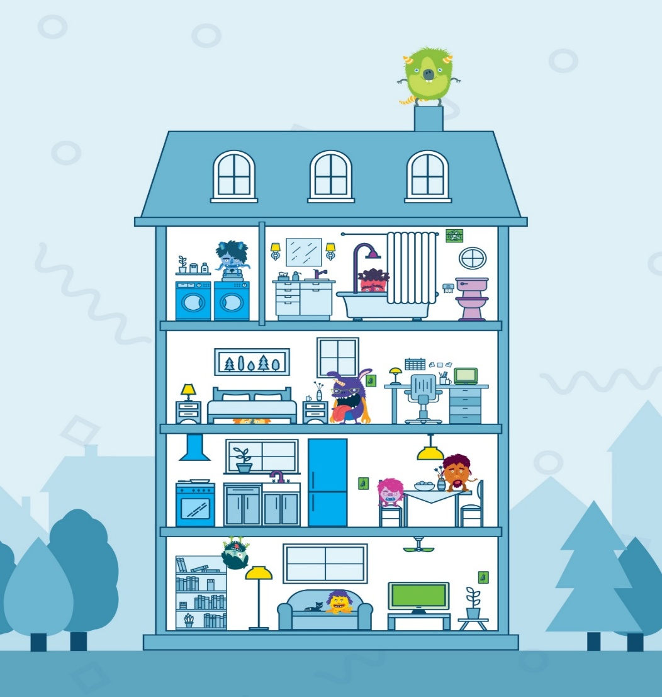


Fuzzy’s Energy House
Let’s help Fuzzy on his mission to save energy at home.
Notes:
Summarize the facts of the game to be more effective
Use the game to teach

Slide 8

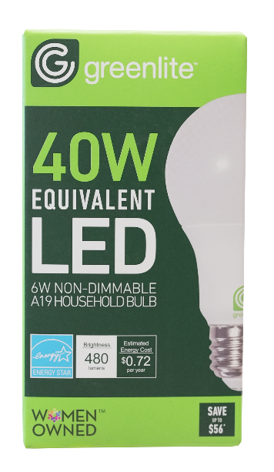

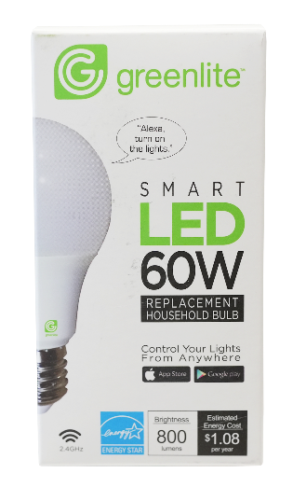
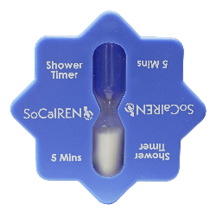
Everything we helped Fuzzy replace in the scavenger hunt is what you’ll get in your kit.
You may already be using some of these items at home. If you’re not, install the items in your kit with a parent/guardian, and you and your family will be more energy efficient!
Energy efficient =
Less energy used and wasted
Lower costs
Better for our environment

Slide 9
Specter’s Mission
I’m on a mission to make my community climate-resilient!
Notes:
Hi, Class! How’s everyone doing today? (Pause for responses) Awesome! My name is Mr. O'Neal, but you can call me Ryan. Today, we’re going to learn how to be Super Energy Savers! We’ll answer some fun questions, play games, and even get some special gifts!
But first, we have a few simple rules:

Slide 10

Warm Up
What is a type of plant that provides oxygen, clean air, healthy soil, and is a home to many different animals?
Write or draw your guess on your worksheet.
Hint: You can find many of them in our community.
Notes:
Use word bank questions;
Energy efficiency: what is energy? Draw picture or write it down
Ex.. Phone and phone charger

Slide 11
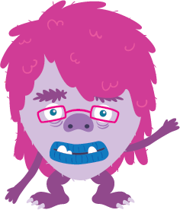
Did you write or draw this?
A tree!
Trees support our community, and it is important that we do our part to protect and support nature!
We can plant more trees in our communities to help us be climate resilient.
Resilient means strong, healthy, and resourceful.
Notes:
Use word bank questions;
Energy efficiency: what is energy? Draw picture or write it down
Ex.. Phone and phone charger

Slide 12


Climate Resiliency? What is that?
In a resilient community, people work together to protect the planet.
A climate-resilient community is strong and prepared to handle different weather-related challenges.
3 actions your community can do to be resilient:
Save energy
Conserve water
Grow plants

Slide 13
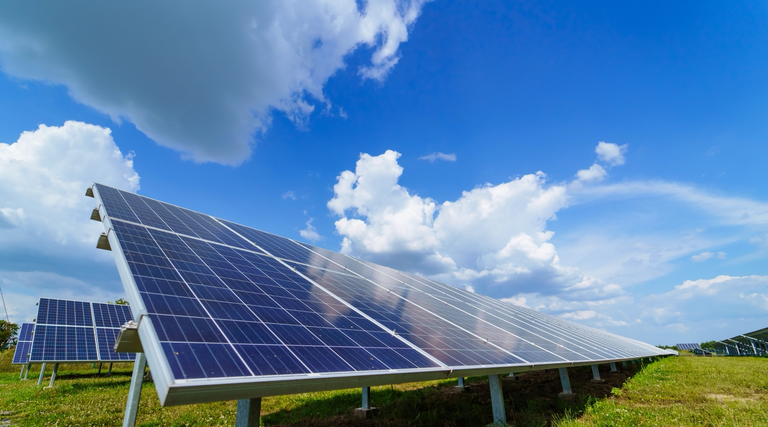

Save Energy
Nature gives us the sun and wind, which can be turned into energy.
Solar Panels
Wind Turbines

Slide 14

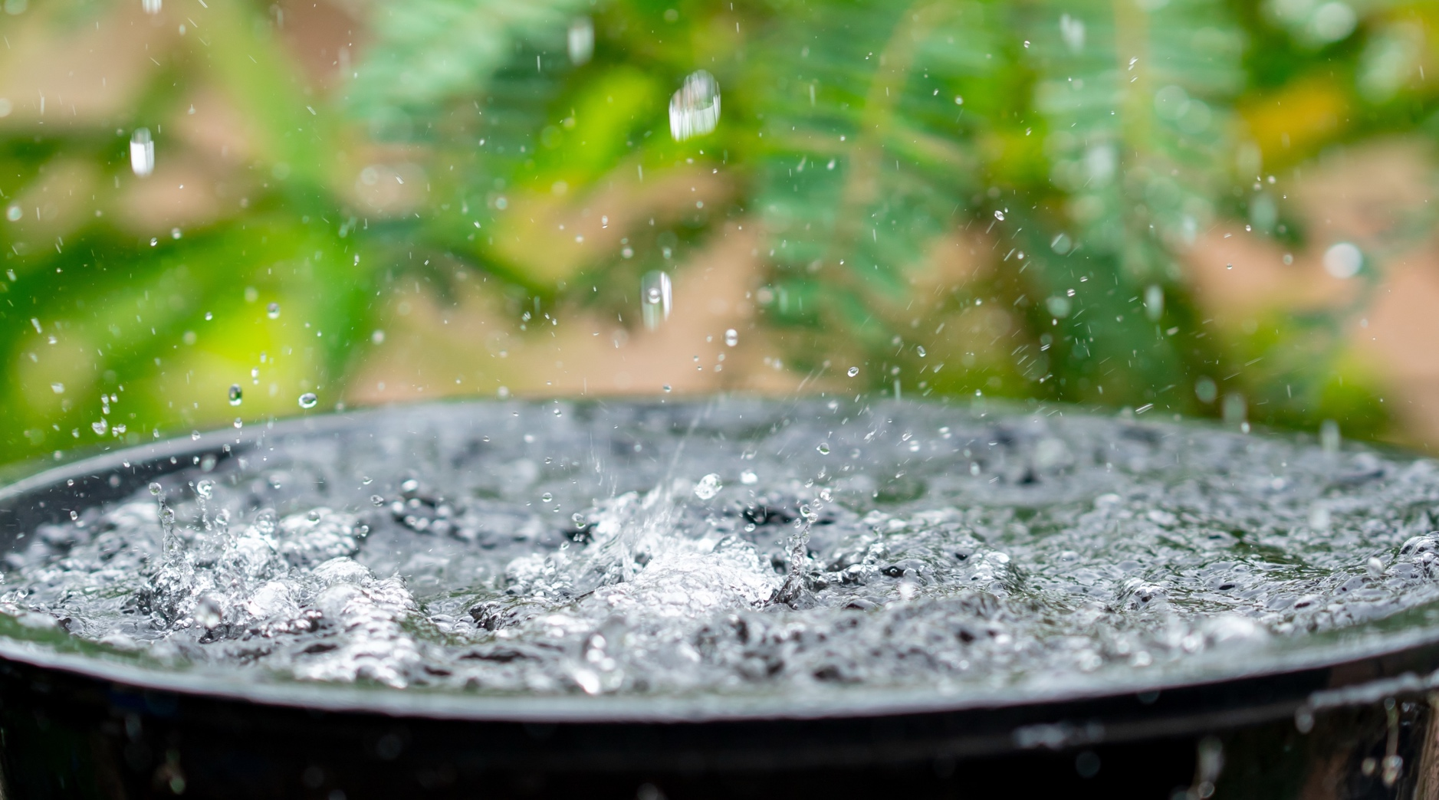
Conserve Water
Nature gives us rain, which we can store and use later.
Water Reservoir
Rain Barrel

Slide 15
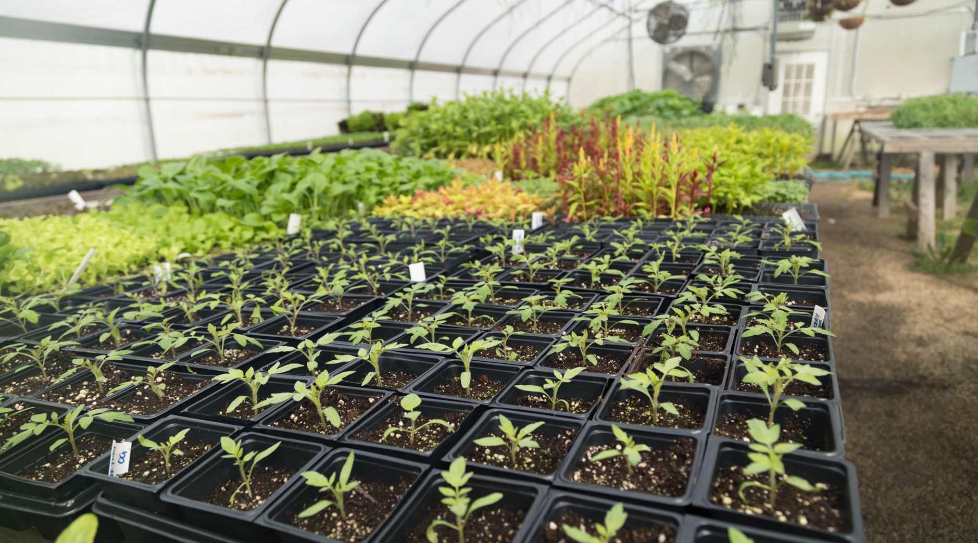
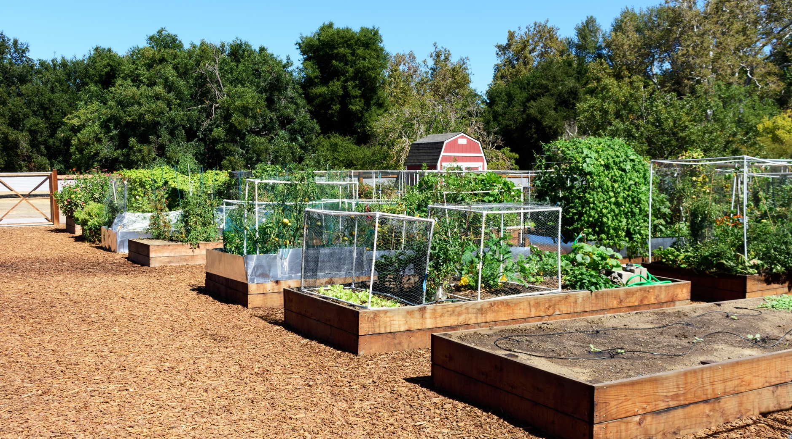
Grow Plants
Nature gives us land, sun, and rain, which can be used to grow plants and food.
Greenhouse
Community Garden

Slide 16
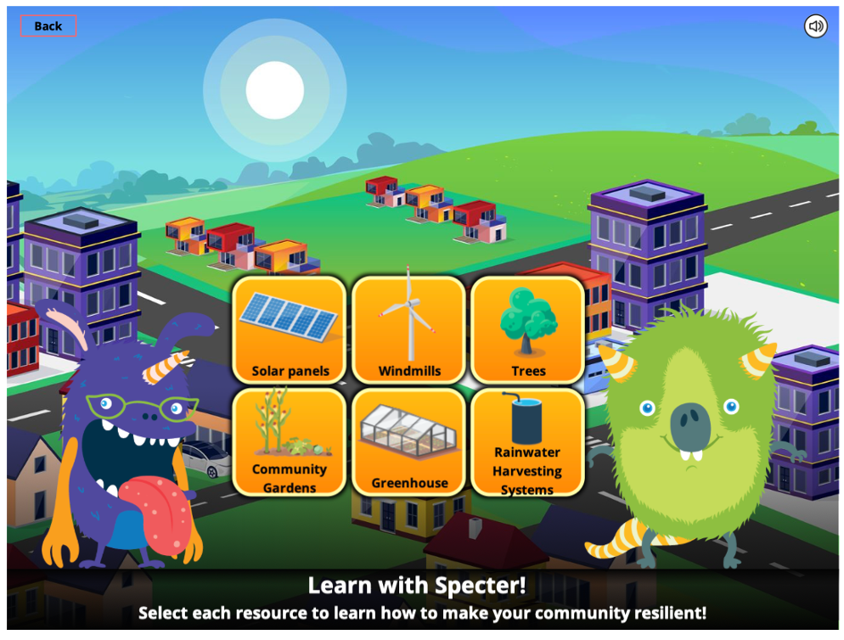
Specter’s Resilient Community
Let’s help Specter make his community climate-resilient!
Notes:
Summarize the facts of the game to be more effective
Use the game to teach

Slide 17
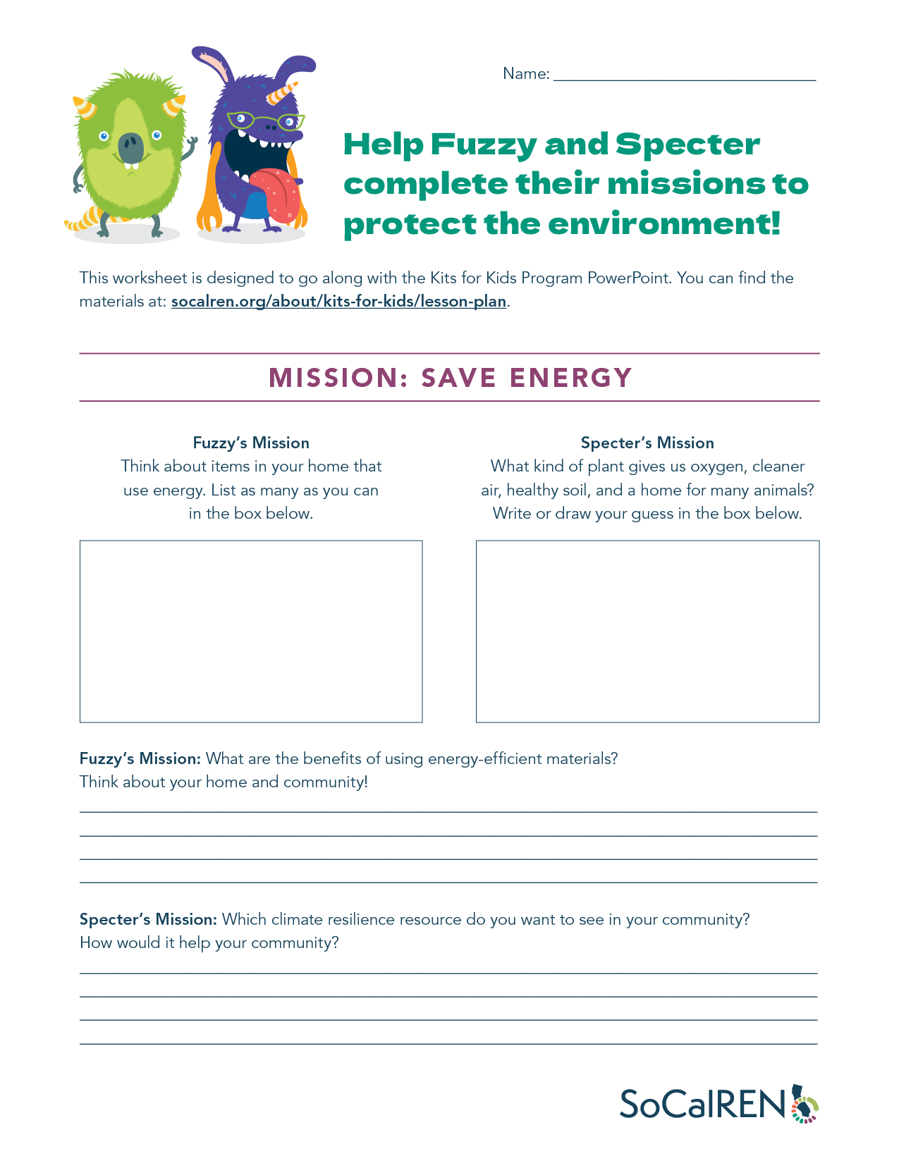
Energy Efficiency and Climate Resiliency Cooldown
Answer the questions on your worksheet, and consider sharing with the class:
What are the benefits of using energy-efficient materials? Think about your home and community.
Which climate resilience resource would you like to see in your community? How would it help your community?
Notes:
Simplify this
Go through together

Slide 18
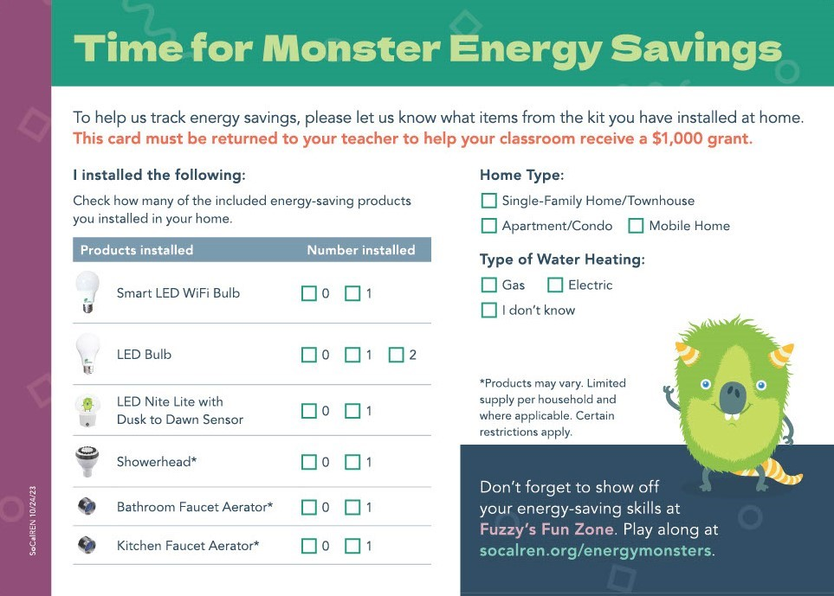
Congratulations!
You’re on your way to strengthening your community. Your kits can help you do your part to make your home, community, and environment more energy-efficient and resilient.
When you go home, get an adult to help you install your kit. Then return the student verification card to your teacher. You could help your class get $1,000!
Thanks for helping Fuzzy and Specter with their monster missions!

